Slide 1
DISPLAY TECHNOLOGY

Slide 2

Often referred to as a monitor, the display is the most-used output device on a computer.
Most desktop displays and portable computing devices use liquid crystal display (LCD).

Slide 3
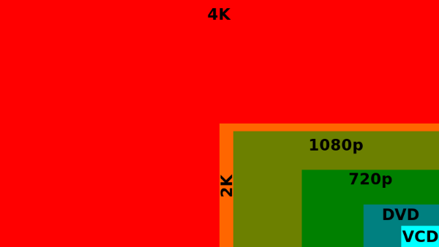
Standards and Resolution
Resolution is number of individual dots of color, known as pixels, contained on a display.

Slide 4
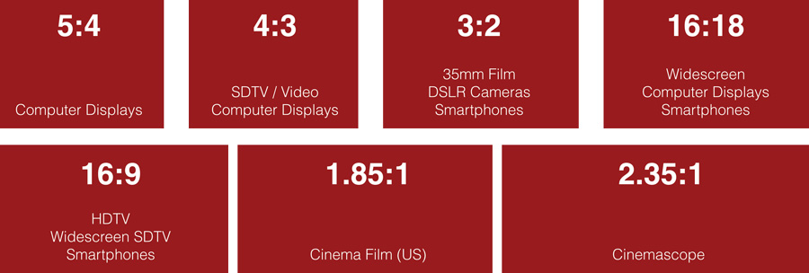
Viewable area is the measurement of a display without its outside casing.
Aspect ratio is ratio of the width of the display screen to the height (in most cases it is 16:9).

Slide 5
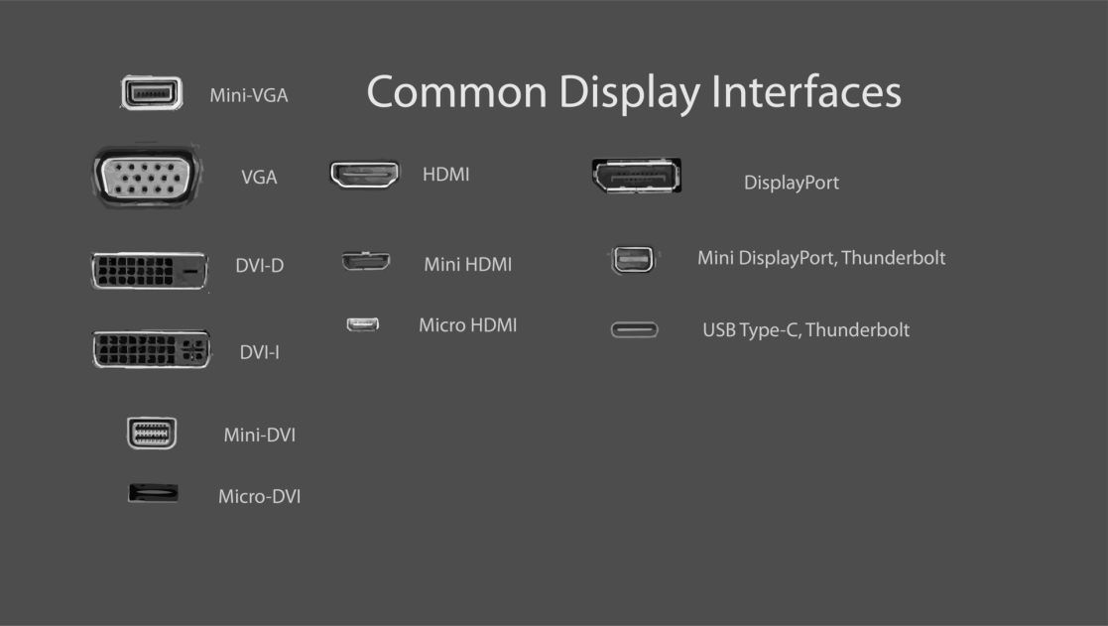
Connections
The signal can be in analog or digital format.
The most popular types of connectors are: VGA, DVI, HDMI, DisplayPort, USB Type C, …

Slide 6
A Brief History of Displays
Panels of light bulbs
Line printers
CRT displays
Modern display technologies

Slide 7
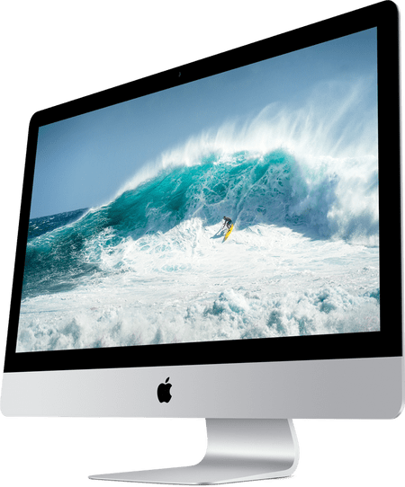
LCD Monitors
LCD is made of two pieces of polarized glass that contain a liquid crystal material between them.
LCD technology works by blocking light.
LCD technologies are active matrix and passive matrix.

Slide 8
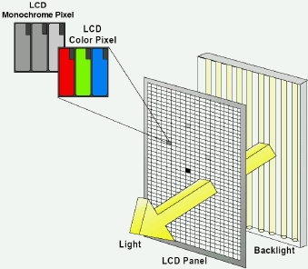
Active matrix technology
A thin film transistor (TFT) arranges tiny transistors and capacitors in a matrix on the glass of the display.
The capacitor is able to hold the charge until the next refresh cycle.

Slide 9
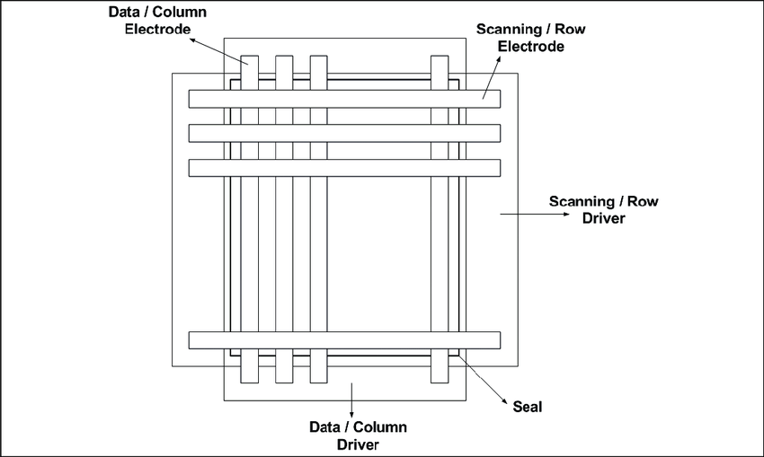
Passive matrix
This type of LCD display uses a grid of conductive metal to charge each pixel.
It is slow and imprecise compared to active matrix technology.

Slide 10
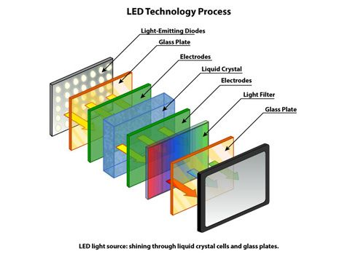
Light emitting diode (LED)
An LED screen is actually an LCD screen, but instead of having a normal backlight, it uses light emitting diode.
Three main configurations for LED screens are: full array, edge lit and direct lit.

Slide 11
FULL ARRAY: This method is considered the best LED backlight type. The LED’s are distributed evenly behind the entire screen.
EDGE LIT: With an edge lit screen, the LED’s are placed at the peripheral of the screen. It can be all around the screen or just on some sides. This allows the screen to be very thin.
DIRECT LIT: The LED’s are placed directly behind the screen. Monitors with this type of technology can’t be very thin because of the space required behind the screen to add LED’s.

Slide 12
Display Attributes
Resolution
Viewable Area
Viewing Angle
Brightness
Contrast Ratio
Response Rate

Slide 13
Important Dates
1964 – The Uniscope 300 had a built-in CRT display.
1965 – Touch screen technology was invented by E. A. Johnson.
1973 – The Xerox Alto included the first computer monitor.
1976 – The Apple I and Sol-20 were the first computer to have a built-in video output port.
1977 – LED technology was invented by James Mitchell.
1977 – The Apple II allowed for color display on a CRT monitor.
1987 – The first VGA monitor was realised by IBM.
1998 – The Apple Studio Display was one of the earliest color LCD monitors for desktop computers.
2003 – LCD monitors outsell CRT monitors for the first time.
2010 – AMD and Intel, along with many monitor manufacturers, announced they were phasing out support for VGA.

Slide 14
J. Stanković RI 48/2019
A. Imami RI 111/2019

